Slide 1



VAISHNAVII KOLLI-2620040020
HARSHITHA-2620090115
AISHWARYA-2620040059
CLINIC APPOINTMENT
PRESCRIPTION MANAGER
//
1

Slide 2
ABSTRACT
This project is a simple Java-based Clinic Appointment and Prescription Management System designed to reduce the difficulties of manual record-keeping. It allows users to store patient details, schedule and view appointments, and maintain prescription records through a user-friendly menu-driven system. The project uses Java concepts such as classes, objects, methods, conditional statements, loops, and data structures to manage clinic information efficiently. Overall, it helps organise patient records, appointments, and prescriptions systematically while demonstrating how Java can be used to develop a practical real-world application.
2

Slide 3
Understanding Problem Statement
•Problem:
•Managing patient appointments and prescription details manually can take time and may cause mistakes.
•Proposed Solution:
•Create a simple menu-driven Java application that keeps appointment and prescription information organised.
•Main Features:
• Add appointment details
• View appointment details
• Add prescription details
• View prescription details
• Exit the system
3

Slide 4
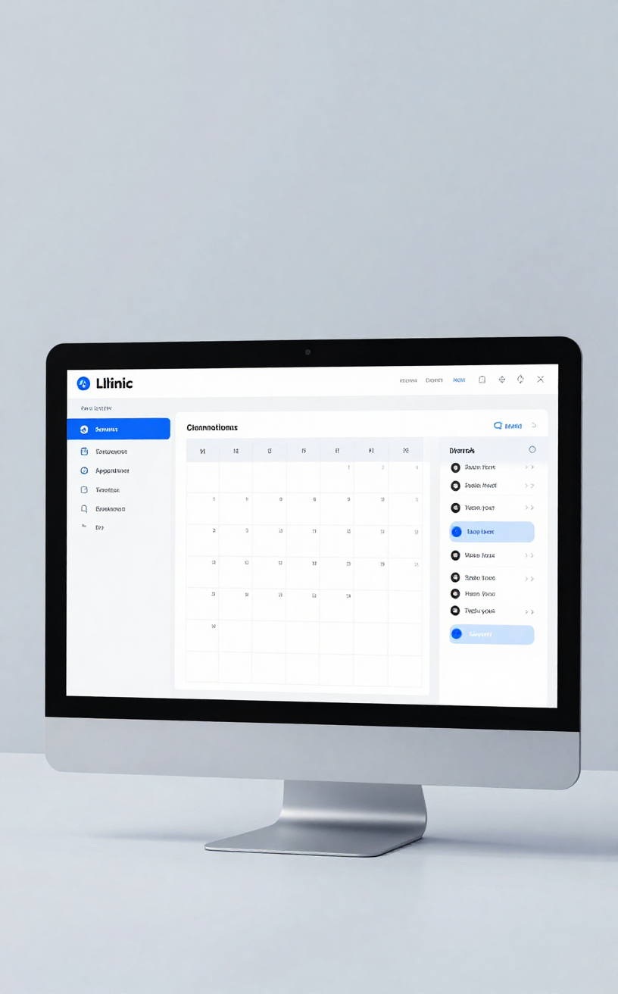
C O-1
Java Basics Used
• Variables and data types – store names, IDs, dates, and other details.
• Scanner – accepts input from the user.
• Operators – perform calculations and comparisons.
• If-else – checks conditions and choices.
• Boolean values – represent states such as availability
4

Slide 5
CO-2
•Control Structures and Methods
• switch-case – provides the menu options.
• do-while loop – keeps the program running until Exit is selected.
• Methods – divide the program into smaller tasks.
• Parameters and return values – pass information between methods.
• Reusable methods make the program easier to understand and maintain
5

Slide 6
CO-3
Modular Programming
Methods
Enhanced for-each Loop
Recursion
1D Arrays
2D Arrays
8

Slide 7

Project Implementation
• Patient details are entered through the console.
• Appointment details are stored and displayed.
• Prescription information is recorded for the patient.
• Menu options control the flow of the program.
• Conditions help validate choices and appointment status.
• The project demonstrates how Java programming can solve a real-world problem
6

Slide 8
Clinic Appointment & Prescription Manager
Geo-tag Photo and GitHub Link
GITHUB LINK
https://github.com/vaishnavikolli471-png/JAVA-PROJECT-SEC-11-CLUSTER-3-PROJECT-8
7

Slide 9
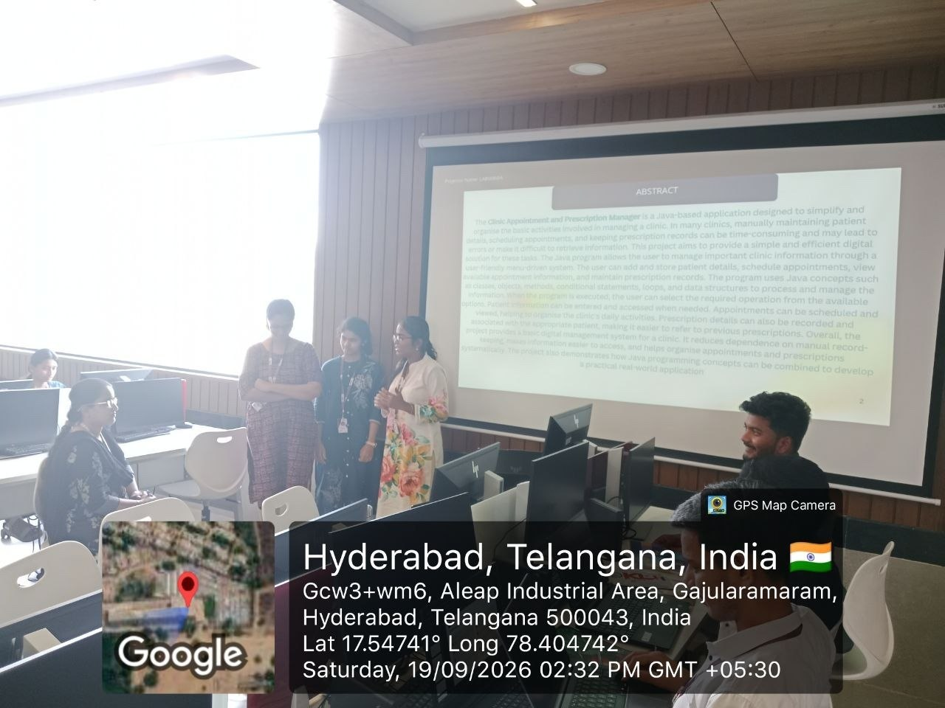
GEOTAG

Slide 10


